Slide 1

Novemeber 20, 2021
Cryptocurrency Prior & Post Pandemic

Slide 2
Agenda
Our questions
Framework
Data retrieval
Visualizations
Code
Analysis

Slide 3
Questions:
1. Is Crypto a better investment than dollars?
2. Which crypto is our best investments?
3. What effect if any did the pandemic have on crypto?
4. Is there any relationship between the dollar and crypto performance?

Slide 4
"
2. How many cryptocurrencies are there? What are they worth?
More than 13,000 different cryptocurrencies are traded publicly, according to Nomics.com, a market research website. And cryptocurrencies continue to proliferate, raising money through initial coin offerings, or ICOs. The total value of all cryptocurrencies on Oct. 22, 2021, was more than $2.5 trillion, having fallen off an all-time high above $2.6 trillion days earlier. The total value of all bitcoins, the most popular digital currency, was pegged at about $1.2 trillion.

Slide 5

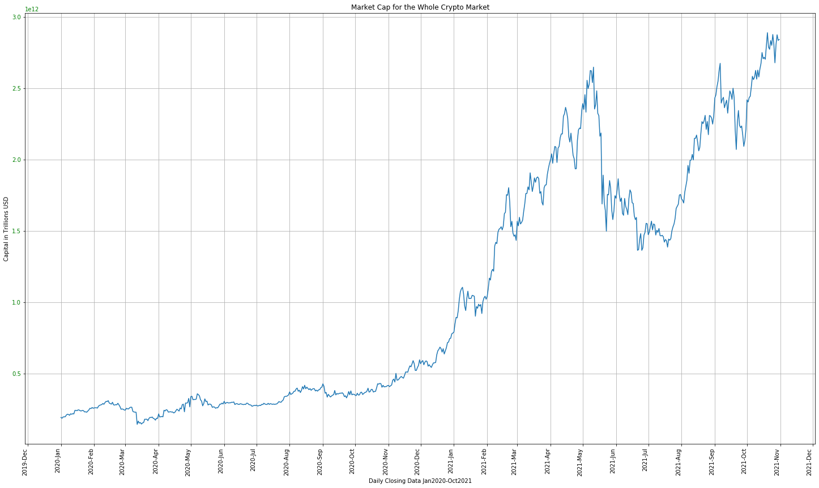
Market Cap for the Whole Cryptocurrency

Slide 6
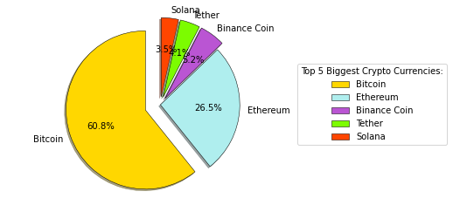
Top 5 Market cap crypto
2021
Top 5 Biggest Crypto Currencies
Bitcoin 60.8%
Ethereum 26.5%
Binance Coin 5.2%
Tether 4.1%
Solana 3.5%

Slide 7
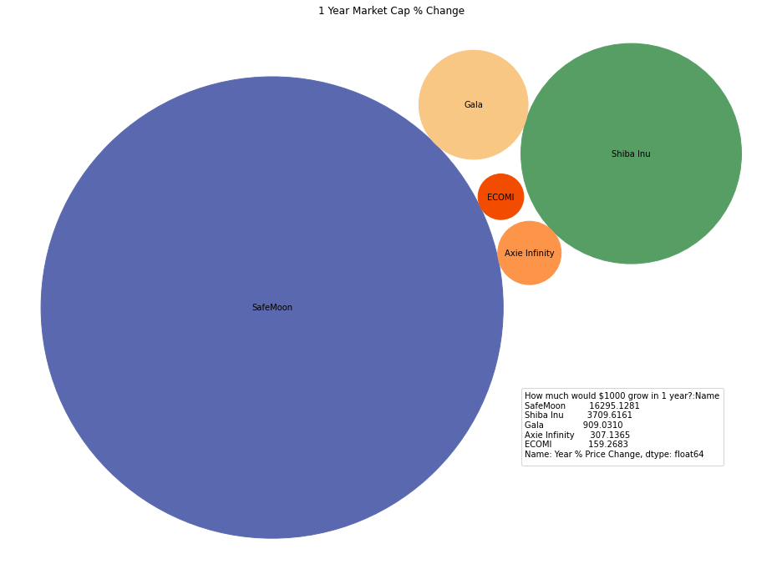
1 Year Market Cap % Change

Slide 8
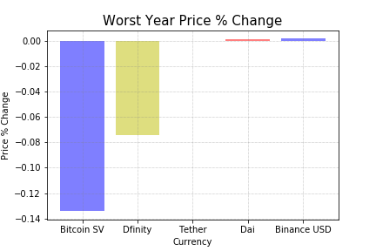
Which investments gives the biggest revenue?

Slide 9
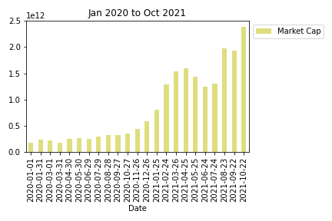
Pandemic crypto Market
Compared 2020 to 2021
r-squared value

Slide 10
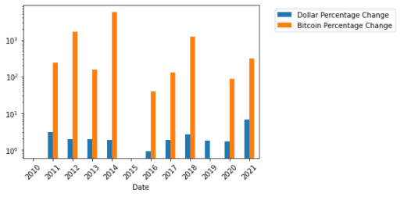
Dollar Percentage Change vs Bitcoin Percentage Change
2021
2020

Slide 11
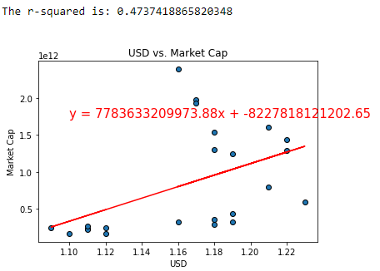
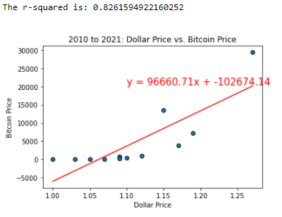
USD_vs_Crypto Market_r
USD_vs_Bitcoin with r

Slide 12
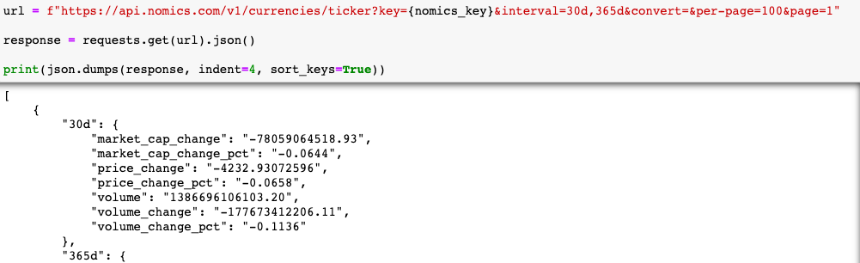
API retrieve code
API Url
response

Slide 13
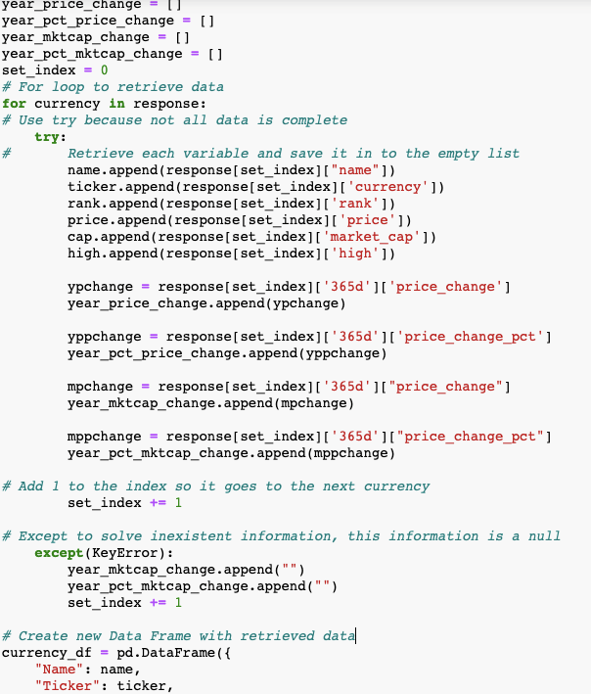

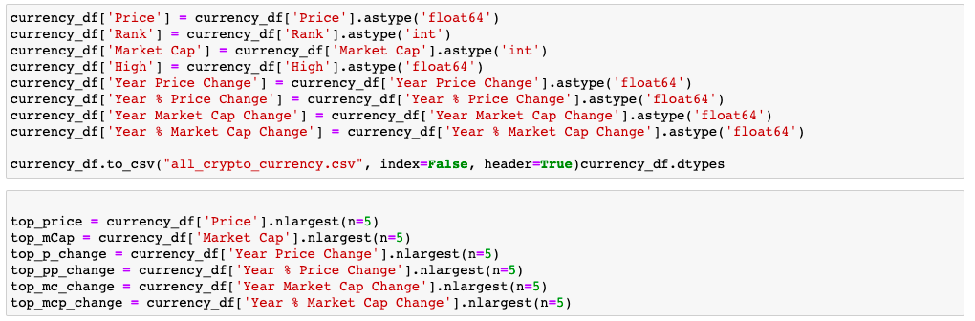
List to hold variables
Loop to retrieve data from response
HOW TO CROSS THE ROAD
Formatting data to retrieve top 5

Slide 14
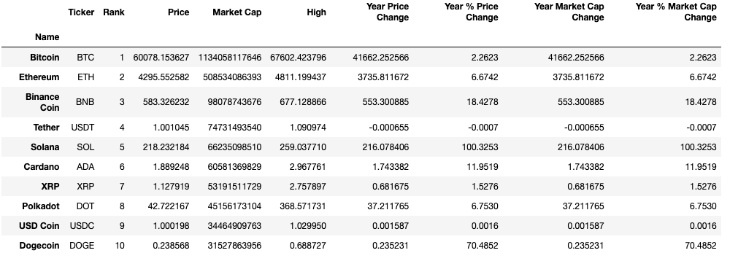
DataFrame
Bitcoin
Cardano
Ethereum
Solana
USD Coin
XRP
Polkadot
Dogecoin
Tethereum
Binance Coin

Slide 15
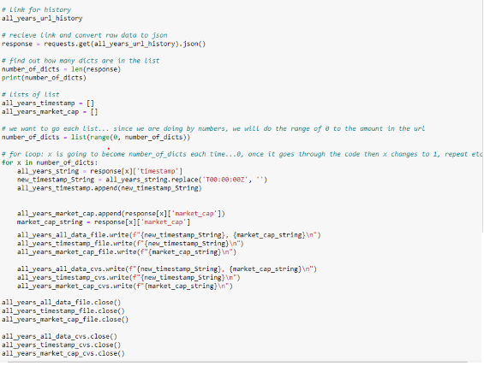
Dollar crypto comparison code
Highlight 2
Highlight 3

Slide 16
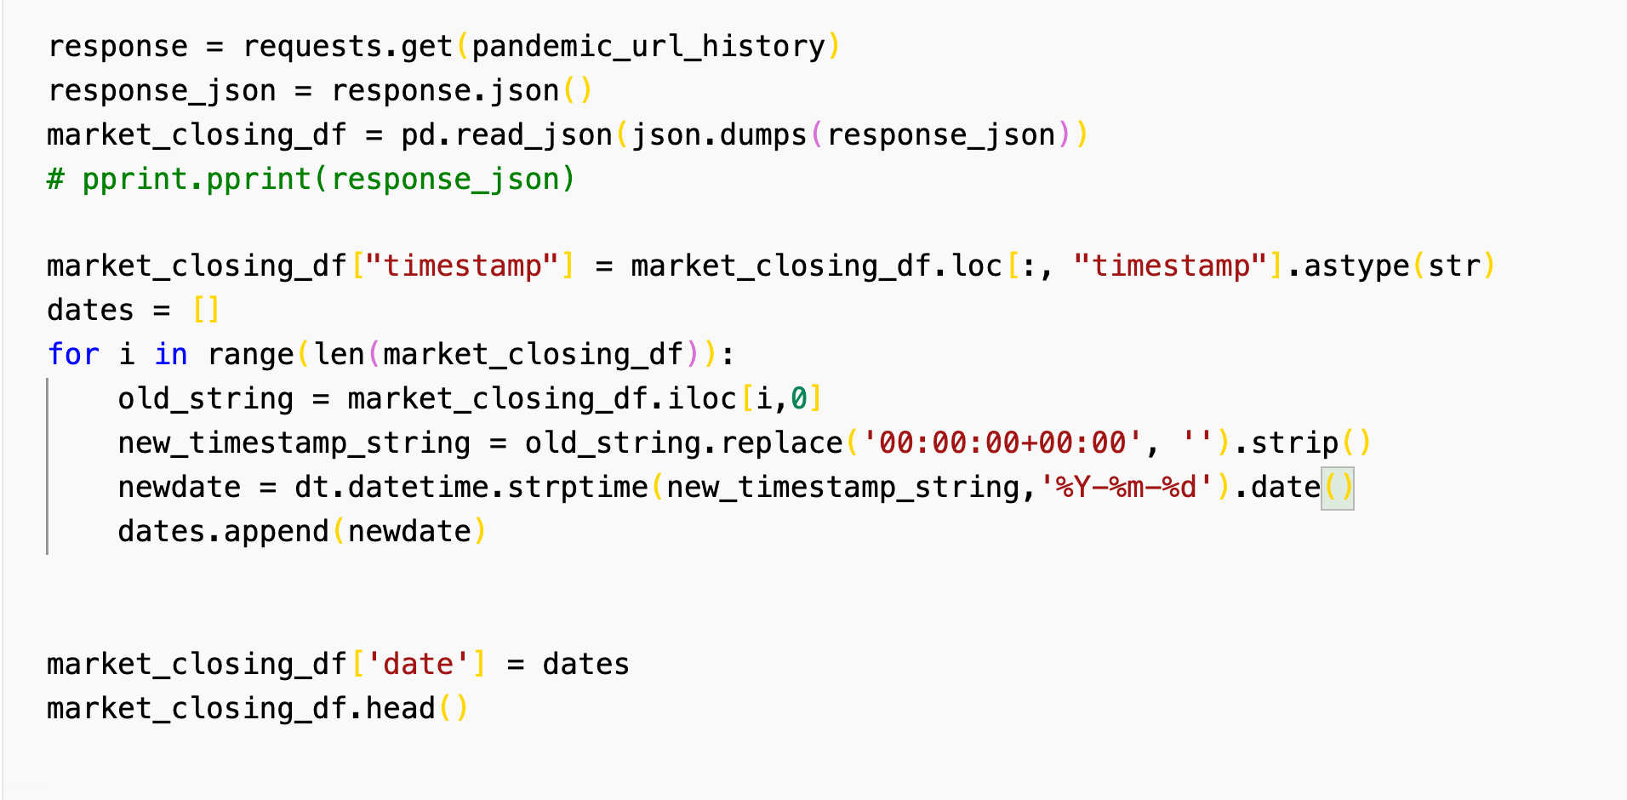
Market Cap Closing

Slide 17
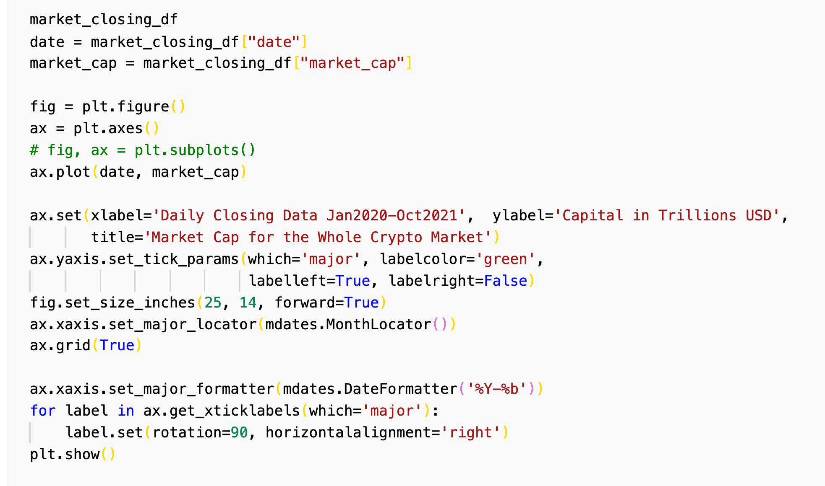
Market Cap Closing

Slide 18
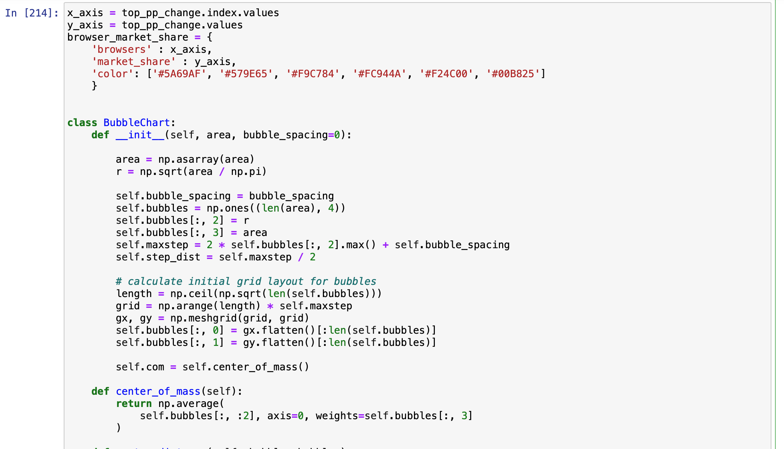
Bubble Chart

Slide 19
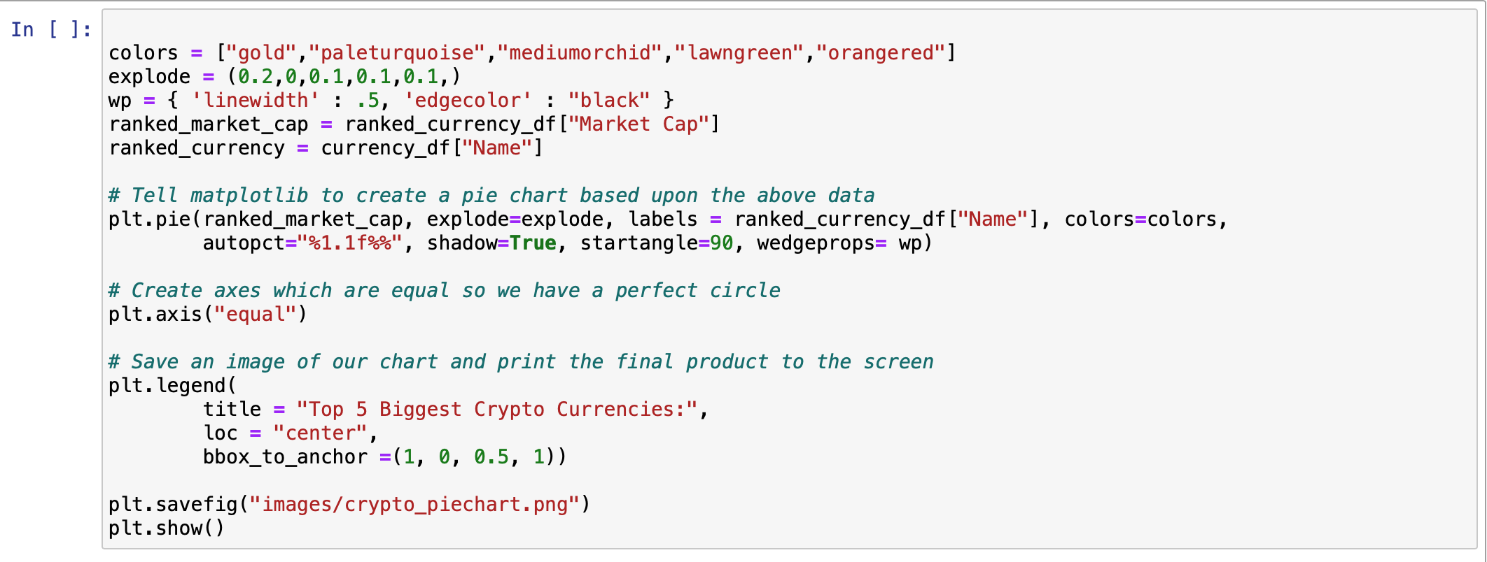
Bubble Chart

Slide 20
USC Viterbi School of Engineering
Thank You
Presentation by:
Sam, Kevin, Leo and LaQuita

